Slide 1

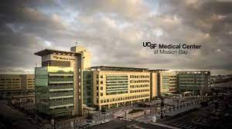
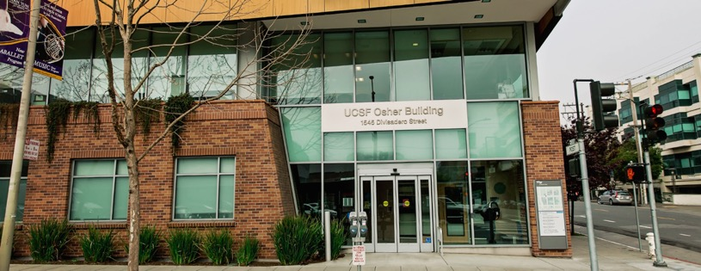
Achieving Success as a Clinician Strategies for Succeeding in Academia when your Primary Role is Focused on Providing Clinical Care

Slide 2
Panelists
Erica Brode, MD, MPH
Rashmi Manjunath, MD
Paul Nadler, MD
Notes:
Succinct introduction to our role here at UCSF

Slide 3
Agenda
Community Building
Topics relevant to success, satisfaction, happiness and promotion
Questions and Answers

Slide 4

What was the biggest thing that surprised you about working at UCSF that you learned AFTER starting your work?
Notes:
Breakout Rooms (5 minutes)

Slide 5

Why Have We Chosen to Practice Clinical Medicine at UCSF?
Notes:
Each presenter gives their mission statement

Slide 6
Do you understand what is required in your academic series for advancement? If not, how do you find out?
https://senate.ucsf.edu/faculty-handbook
Notes:
Where to find it

Slide 7

How to have a productive annual meeting with your division or department Chief or Chair?

Slide 8

How to promote diversity, equity and inclusion in your work

Slide 9

How to promote diversity, equity and inclusion in your work
https://medschool.ucsf.edu/differences-matter

Slide 10
How to promote diversity, equity and inclusion in your work
TEACHING & MENTORING
Designing and/or teaching courses or curricula that meet the needs of disadvantaged students
UNIVERSITY & PUBLIC SERVICE
Engagement in seminars, conferences, or institutes that address the concerns of women, under- represented minorities and other marginalized and under-represented groups (i.e. LGBTQ and people with disabilities)
PROFESSIONAL ACTIVITIES
Promoting welcoming classroom environments for students from culturally diverse groups
Contributions-to-Diversity-Equity-and-Inculsion-Guidelines-for-the-Development-of-Statements-for-UCSF-Faculty.pdf

Slide 11
Mentoring
How do you know if you are in a good mentoring relationship?
Goal-specific Mentors
https://facultyacademicaffairs.ucsf.edu/faculty-life/mentoring

Slide 12
How to choose which opportunities to take on (for example- committee work)
When?
https://senate.ucsf.edu/description-of-standing-committees

Slide 13

Organization of materials for CV and keeping the document updated

Slide 14
How to develop "outside" references for advancement to Associate Professor and the general topic of looking ahead

Slide 15

Teaching
How to balance teaching with clinical and administrative work
How teaching and education fits into academic advancement

Slide 16
Teaching Continued…Faculty development on the run
LACE mini-modules on feedback: http://tiny.ucsf.edu/feedbackskills
F2 Video Modules: https://meded.ucsf.edu/faculty-educators/faculty-development/bridges-faculty-development-foundations-2-resources
AOC initiative resources: https://meded.ucsf.edu/faculty-educators/faculty-development-all/aoc-initiative-resources-and-tools/aoc-initiative-resources-clinical-learning-environment#
Center for Faculty Educators: https://wiki.library.ucsf.edu/display/TBS
TOP observation program
Skills workshops
UCSF TEACH certificates
Educational Scholarship Conference (ESCape)
Teaching Scholars Program (TSP)

Slide 17

Clinical Leadership
At unit/clinic, divisional, department and health system levels
Operations, quality improvement, patient safety, patient + physician experience, utilization management
Want to develop skills:
LEAN Management Training
UCSF Leadership Institute
Join a taskforce or committee
Show up to meetings and events

Slide 18

Working effectively with your interprofessional peers
Strategies for Success:
Cultivate respect and curiosity
Get to know your interprofessional team
Be slow to judge others
Teach, train, research, write, and collaborate with other professions whenever possible
Avoid viewing any other profession as an extension of yours; instead see how they complement each other to care for the whole patient

Slide 19
Imposter Syndrome

Slide 20
Burnout
Burnout syndrome
"a chronic response to stress in the workplace characterized by a physical, mental and emotional state of exhaustion that reduces the sense of personal and professional fulfillment" (Maresca et al, 2022)
In 2023, 45.2% of physicians experienced burnout.
Risk factors
Conflict
Work Life Imbalance
Lack of Control or Recognition
Poorly defined roles and boundaries
Poor Sleep, Exercise or Eating Habits
Sometimes it is more than burnout and may represent depression or anxiety
Ways to Manage
Vacation or rest periods
Social and emotional support
Physical activity and self-care
UCSF Resources
FSAP
COPE
Caring for the Caregiver
Chaplains
UCSF Wellbeing
Maresca, G.; Corallo, F.; Catanese, G.; Formica, C.; Lo Buono, V. Coping Strategies of Healthcare Professionals with Burnout Syndrome: A Systematic Review. Medicina2022,58,327. https:// doi.org/10.3390/medicina58020327

Slide 21

Keeping Up With the Medical Literature

Slide 22
Questions?

Slide 23
Thank You!!

