Slide 1
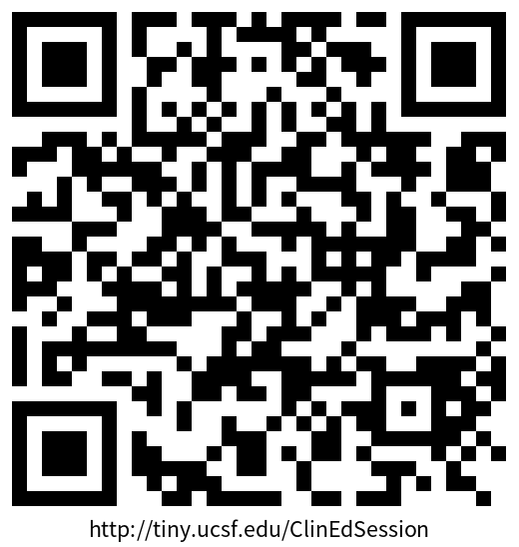
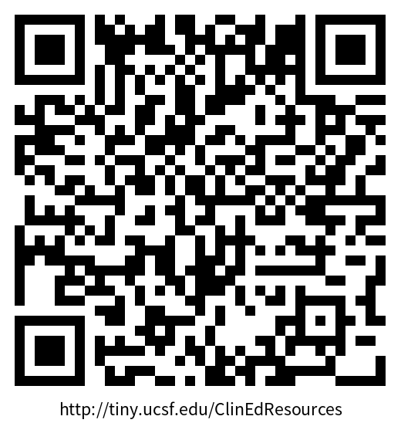
Achieving Success as a Clinician Educator
We will start at 235PM
Please consider renaming yourself on Zoom to include your School/Program and your pronouns if you're comfortable
Materials for this session: https://tiny.ucsf.edu/ClinEdSession
We will be using breakout rooms, Zoom polls, and a shared word doc on One Drive during this session
Pls let us know if you have any accessibility needs
Denise M. Connor, MD
Angel Kuo, EdD, CPNP
Cindy Lai, MD
Diana Nguyen, DDS
Crystal Zhou, PharmD
Aug 27, 2025

Slide 2

Roadmap
Introductions
Breakout groups – Connect, Brainstorm CE Q’s, Share Tips
How do I get started?
How do I gain skills and experience?
How do I approach mentorship?
How do I show my value?
Independent Activity – Mentor Map
Q&A

Slide 3
Breakout Group Activity
Introductions:
Name, Pronouns if you'd like to share, School/Dept
Role at UCSF/Type of teaching you do
One thing you love about being a clinician educator
As a group:
Discuss Q's you have about being a clinician educator: you may consider challenges that are particular to our current context or any general Q's; ask a representative to add your group's Q's to the shared doc
If time, begin discussing the Q's and brainstorm together

Slide 4
What is a Clinician Educator?
Ce
cE
Clinical Work
Curriculum Design
Education
Ed Leadership
Teaching

Slide 5

Lifecycle of a Clinician-Educator
Start - Early
Volunteer teaching
Collaborate on mini-grants
Early -Mid Career
Mentorship
Develop brand/identity
Mid-Late Career
Leadership
Focus
Mentorship
Networking
Apply for leadership positions
Mentoring
Skills building

Slide 6
How do I get started on this pathway?
Make interests known
Share with colleagues, leaders, mentor(s)
Volunteer
What setting do you enjoy teaching in? Volunteer!
Get observed when teaching (CFE “TOP” or PIPE “iTOP”)
Join
Join a project, or talk with a leader about idea aligned with School/Dept's goals
Find
Find a community, workgroups (local and national)
Apply
Apply for Innovation Funding for Education (funded by AME/OME/PIPE)
Understand UCSF landscape
Networking –> Mentors
Students!

Slide 7
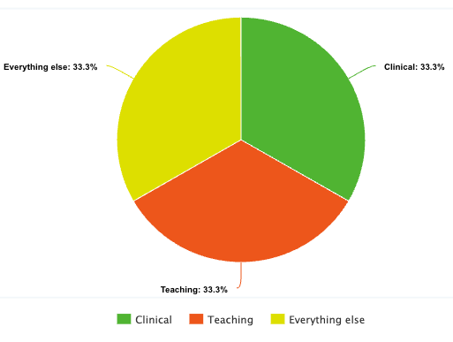
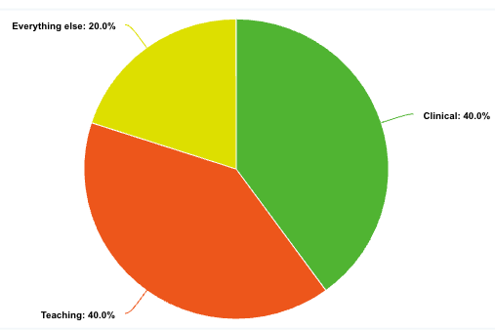
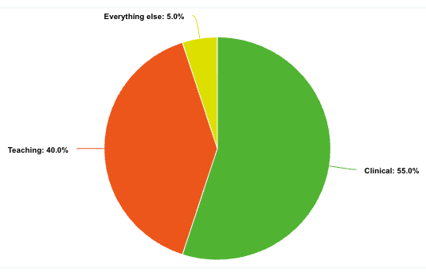
How do Clinician Educators spend their time?
Defined vs undefined schedules
Administrative time?
Everything else
Ed research
School committees
Curriculum committees
Academic senate
Clinical workgroups

Slide 8


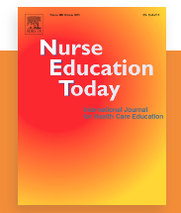

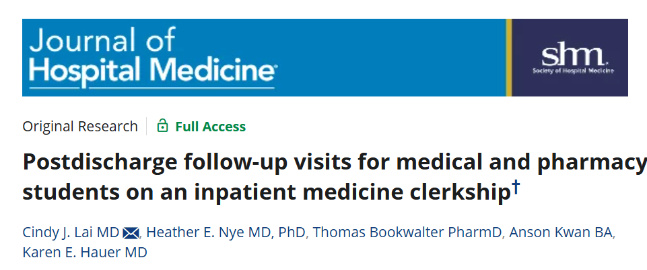
What does HPE scholarship look like?
As a CE you might not consider yourself as doing traditional "research"
Planning curricula/conducting evaluations have value
Consider designing your evals to be publishable
Consider:
UCSF Education Showcase
Academic conference posters & presentations
Manuscript publication
MedEd Portal (open access)
Profession-specific journals on education
MANY journals!

Slide 9
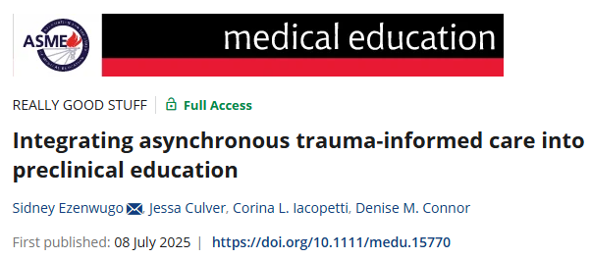
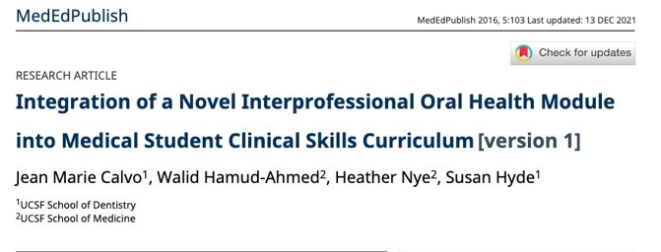
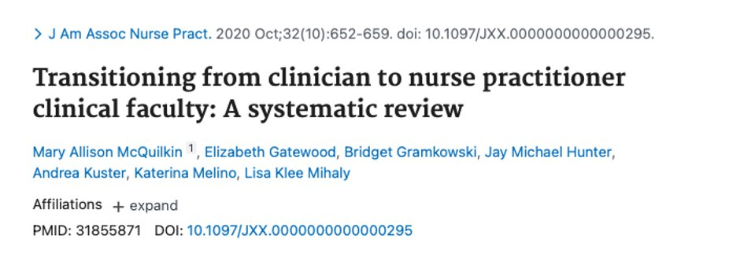
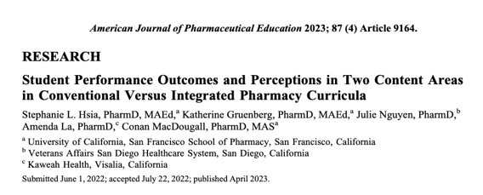
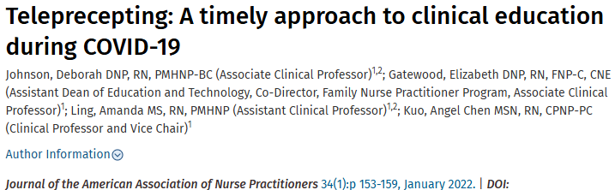
Clinician Educator Scholarship
ClinEd Scholarship can include MANY things!
Curriculum development, implementation
Evaluations, outcomes of training programs
Faculty Development
Can include: research projects, perspectives/narratives, systematic reviews on education in HPE, resources for other educators
Dissemination & Recognition for advancement

Slide 10


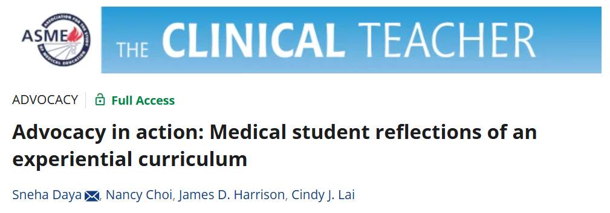
Innovations and PIPE Funding
Innovations & PIPE Funding
Priority areas:
Anti-oppression; Fostering belonging
Climate change
Application of principles of interprofessional education
Use/misuse of AI & technology
Community engagement with partners within & outside UCSF
Assessment for learning for growth
Novel approaches promoting faculty educator development
Innovations Funding for Education: Call for Proposals
 | Innovations Funding | Interprofessional Clinical
Amount | $4-25k | $10k
Concept Deadline | 9/17/25 | 10/13/25
Final Proposal Due | 10/14/25 | 12/19/25

Slide 11
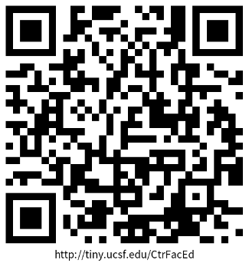
How do I gain skills & expertise?
External Opportunities
National & Regional Conferences
WGEA
AAMC
Specialty/Profession-based (many w/ education tracks)
National Organization of Nurse Practitioner Faculties (NONPF)
National Center for Interprofessional Practice and Education (Nexus Summit),
American Association of Colleges of Pharmacy (AACP) Meeting
UCSF Center for Faculty Educators
Online Resources
Teaching Scholars Program
Teaching Observation Program (TOP)
Interprofessional Teaching Observation Program (iTOP)
Med Ed Grand Rounds
WIPs & Community: ESCape & Med Ed Journal Club; EJE
Visit tiny.ucsf.edu/CtrFacEd to learn more

Slide 12

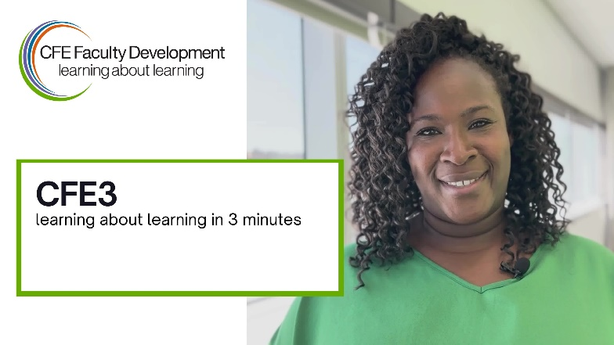


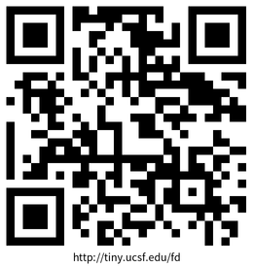
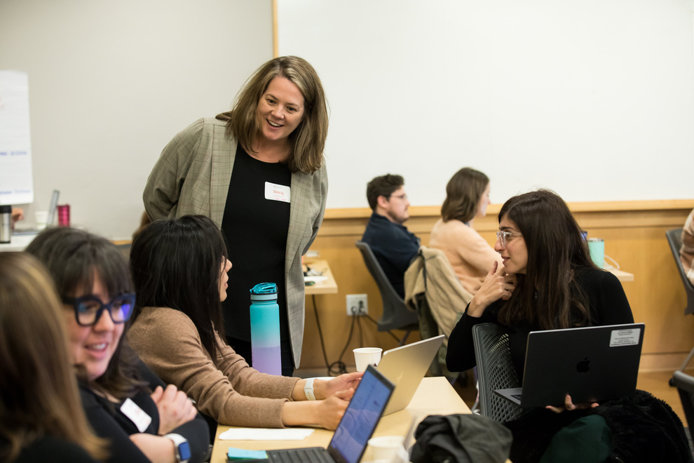
CFE Learning
CFE3's
3-minute videos introducing concepts and skills.
Core Teaching Skills Workshops
1-hour Zoom sessions to develop basic skills in a variety of areas.
From 3-minute videos to core teaching skill workshops and certificate programs, there are resources to help you meet your goals & fit your schedule.
Educator Clinics
3-4 hour in-person or Zoom sessions to further enhance skills in select areas.
Teach for UCSF Certificates
tiny.ucsf.edu/fd
Day-long in-person sessions to develop in-depth understanding and essential skills as health professional educators.

Slide 13
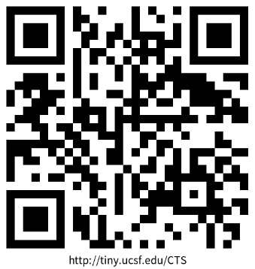
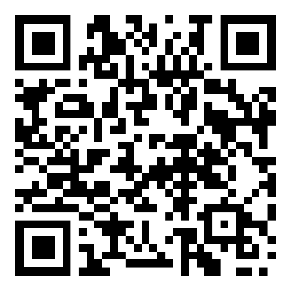
2025-2026 CFE Offerings
Core Teaching Skills
all 12-1pm • Zoom
Microaggressions in the Learning Environment
Thu 9/18 • 2nd date pending
In-the-Moment Feedback
Mon 10/6, Wed 11/05 & Wed 2/11
Small Group Teaching
Wed 11/19 & Mon 2/9
Writing Evaluations
Fri 10/10, Mon 2/23 & Thu 3/5
Teach for UCSF Certificate Days
most 8:30am – 4:30pm • in person only
Thu, Oct 16, 2025 at Mission Bay
Clinical Teaching, Part 1
Quality Improvement & Patient Safety
Mon, Oct 27, 2025 at Mission Bay
Simulation Teaching, Part 1
Thu, Nov 6, 2025 at ZSFG
Clinical Teaching, Part 2
Thu, Feb 6, 2026 at Mission Bay
Interprofessional Teaching, Part 2
Simulation Teaching, Part 1
Tue, Apr 14, 2026 at ZSFG
Clinical Teaching, Part 1
Tue, May 5, 2026 at ZSFG
Clinical Teaching, Part 2
Parts 1 & 2 must be taken in order but do not have to be completed during the same academic year.
Visit tiny.ucsf.edu/teach4UCSF to register
Visit tiny.ucsf.edu/CTS to register

Slide 14

SON Teaching Opportunities
Clinical Teaching
Precepting students in a variety of settings
Primary care, pediatrics, OB / gyn, Acute Care (Inpatient)
Procedural Teaching
Simulation
Didactic Teaching
Small group problem – based learning
Large lectures
Recorded content
Benefits
Expand your educator portfolio
Foster Interprofessional clinical settings
Engage with motivated learners
Become a Volunteer Clinical Professor
Interested?
Contact Angel Kuo at angel.kuo@ucsf.edu or Elizabeth Gatewood at elizabeth.Gatewood@ucsf.edu
Check out the Preceptor Portal https://nursing.ucsf.edu/for-preceptors

Slide 15

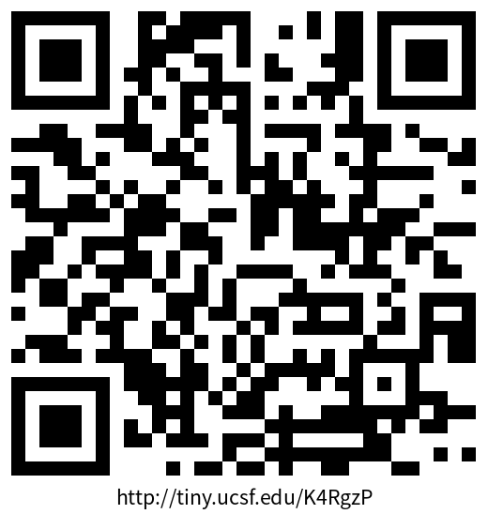
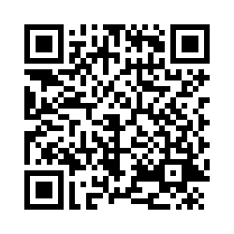


Get Involved with PIPE!
Learn more about opportunities for faculty to get involved https://interprofessional.ucsf.edu/opportunities-faculty
Counts as Campus Teaching/Service on your CV in Advance! You will receive interprofessional learner feedback
Facilitate a 2025-26 Core Principles of Interprofessional Practice Session(s): CPIP/IPE 2025-2026 - Facilitator Sign Up Survey
Upcoming IPE Sessions
10/6/2025: Developing Your Conflict Competency
10/20/2025: The Value of Interprofessional Practice
12/5/2025: Leadership & Membership in Team-Based Healthcare
1/12/2026: Roles and Responsibilities
4/13/2026: How will our work get done?
Save-the-Date! 2026 Interprofessional Standardized Patient Exercise (ISPE)
Facilitator sign-up info will be finalized by early 2026
4/27/2026 to 5/1/2026

Slide 16
SOP Teaching Opportunities
Didactic Teaching
Facilitating small group sessions (skills, OSCEs, conferences)
Providing didactic large-group lectures in P1 and P2 themes
Clinical Teaching
Precepting students on IPPEs and APPEs
Precepting students at health fairs and community outreaches
Benefits for you
Promote pharmacy student learning and development
Share your knowledge and expertise with our students
Teaching experience and evaluations for advancement
Hone and develop your teaching skills
Interested?
Contact Sharon Youmans Sharon.Youmans@ucsf.edu or myself!

Slide 17
SOD Teaching Opportunities
Didactic Teaching
Teaching in SOD courses
As a lecturer on a specific topic
Course director
Teaching in Electives
SOD electives
Interprofessional electives
Teaching to non-dental learners
ISPE facilitator sessions
Clinical teaching
Simlab
Clinic floor
RCOs
Outreach events
Benefits for you
Sharing knowledge
Honing teaching skills
Exploring new topics that are of interest
to students and you
Piloting new learning methods
Interested?
Division/Department chair
Course Directors
RCOs/student leaders
New Junior Faculty Development Program
Maria Rina Simon

Slide 18
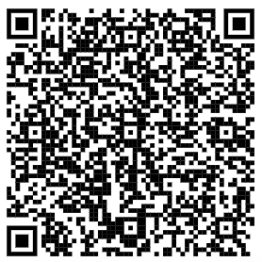
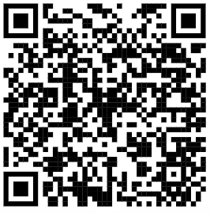
SOM Teaching Opportunities
Benefits for you:
Promote medical student learning and professional development while getting to know students
Practice and hone teaching skills
Receive teaching evaluations for advancement and promotion
Interested?
Curricular phases:
Foundations 1
Foundations 2
Career Launch
Types of teaching:
Small Group facilitation
Lectures
Recording video lessons
Clinical preceptorships
Clinical skills development
Examination grading
Longitudinal coaching
Research mentorship
Teaching opportunities webpage
Teaching interest survey

Slide 19
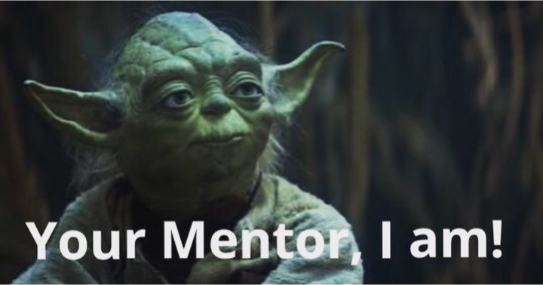
UCSF Mentoring

Slide 20
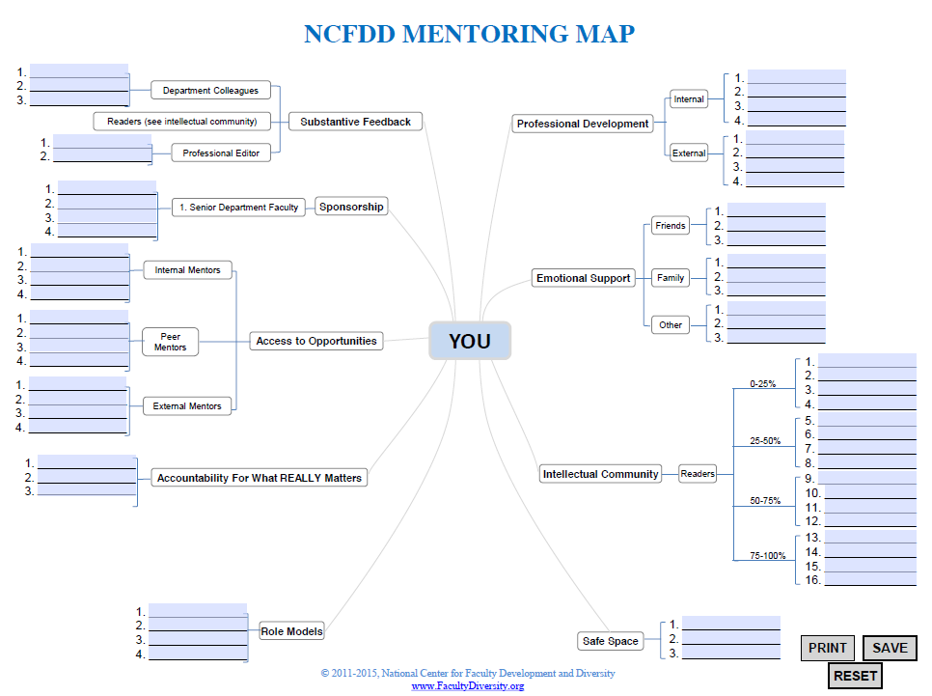
Mentoring Map
National Center for Faculty Development & Diversity

Slide 21
How do I show my value, display my work, and get promoted?
Show value
Share work at division meetings
Ask to be nominated for teaching awards
Apply for AME
Social Media
Display work
Educator Portfolio (part of Advance CV)
Find sponsors
Education Showcase, regional, national education meetings
UCSF Profiles www.profiles.ucsf.edu
Locally and Nationally

Slide 22
Educator Portfolio (within Advance CV) https://facultyacademicaffairs.ucsf.edu/online-systems/Advance/Educator-Portfolio-Guide.pdf

Slide 23
Progression in Clinician Educator
Chang et al (2021)

Slide 24

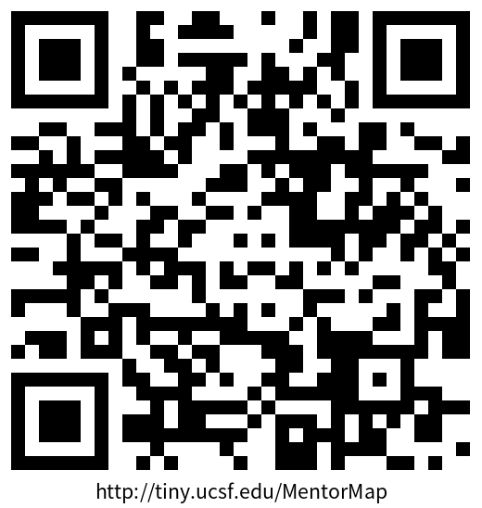
Getting Started: Mentor Map Brainstorm
Notes:
Mentor Map Link: https://tiny.ucsf.edu/MentorMap

Slide 25

Additional Questions, Reflections
Denise Connor – SOM – denise.connor@ucsf.edu
Angel Kuo – SON - angel.kuo@ucsf.edu
Crystal Zhou – SOP – crystal.zhou@ucsf.edu
Cindy Lai – SOM – cindy.lai@ucsf.edu
Diana Nguyen – SOD -- diana.nguyen2@ucsf.edu
Please peruse the Resources Handout for contacts in your School/Department and links to helpful sites and resources: https://tiny.ucsf.edu/ClinEdResources
Notes:
Link to resources: https://tiny.ucsf.edu/ClinEdResources
Link to folder with all session materials: https://tiny.ucsf.edu/ClinEdSession

